Slide 1
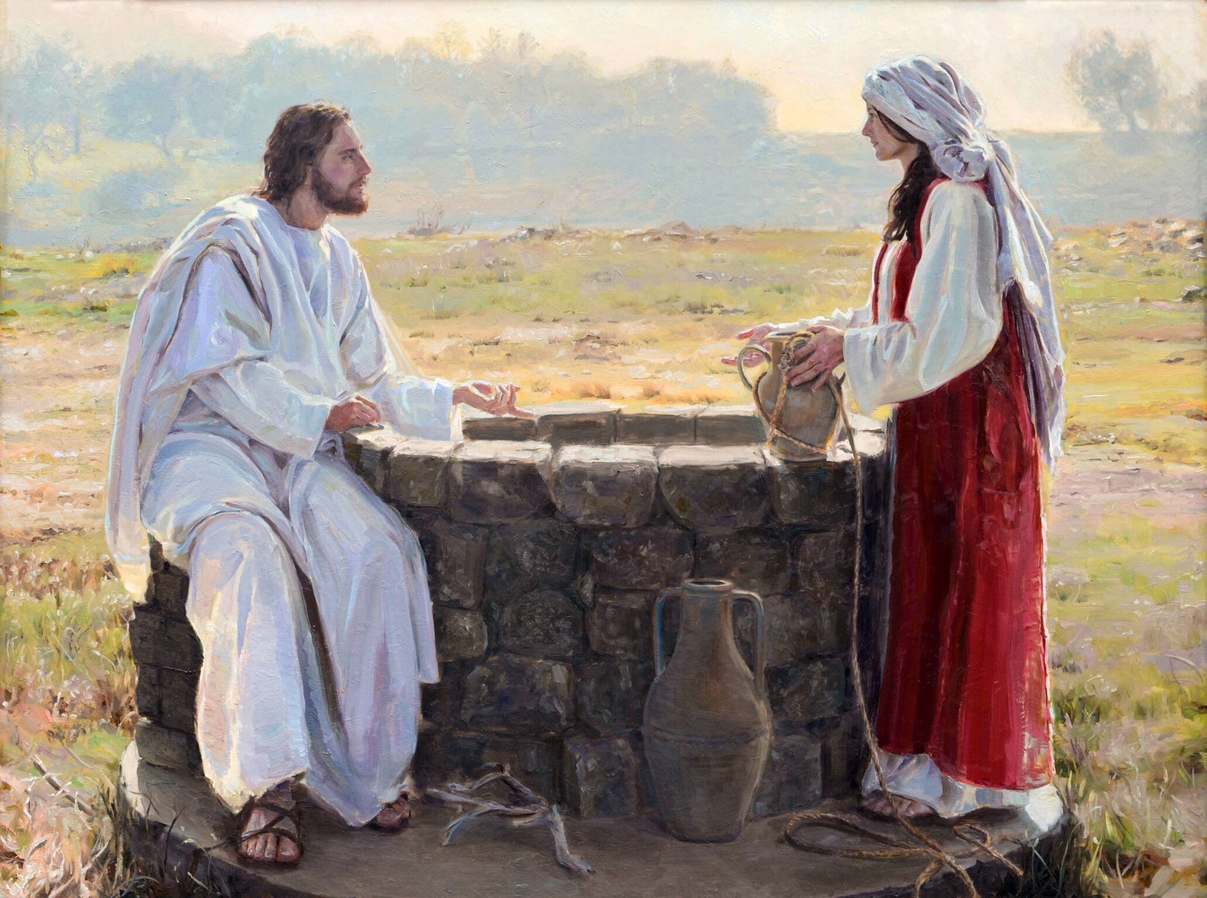
17 The woman answered and said, I have no husband. Jesus said unto her, Thou hast well said, I have no husband:
18 For thou hast had five husbands; and he whom thou now hast is not thy husband: in that saidst thou truly.
19 The woman saith unto him, Sir, I perceive that thou art a prophet.
25 The woman saith unto him, I know that Messias cometh, which is called Christ: when he is come, he will tell us all things.
26 Jesus saith unto her, I that speak unto thee am he.

Slide 2
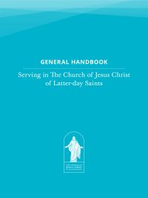
General Handbook Section 14
Men and women who have not married or who are divorced or widowed make up a significant portion of Church membership. Leaders reach out to these members and include them in the work of the Church. Worthy single members should be given opportunities to hold leadership and teaching positions as directed by the Spirit.
Leaders support single members by helping them draw near to the Lord, strengthen their testimonies, and take responsibility for their own spiritual, social, and temporal well-being.

Slide 3
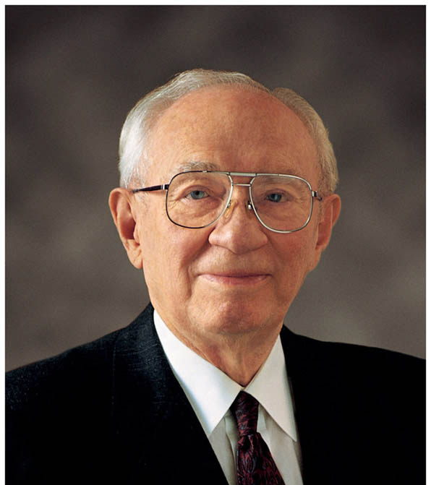
Somehow we have put a badge on a very important group in the Church. It reads “Singles.” I wish we would not do that. You are individuals, men and women, sons and daughters of God, not a mass of “look-alikes” or “do-alikes.” You are precious and important to Him. You are precious and important to the Church. You are precious and important to all of us.
President Gordon B. Hinkley,29 February 1989

Slide 4
PLEASE DO
Be inclusive and be a real friend.
Take time to get to know us and our lives—otherwise ministering will not work—How is this approach different for different people
Build solid relationships in the good times so that we are comfortable to ask for help when needed
Be consistent/keep your promises
Extend callings
Be mindful of our needs and differences—take time to ASK how callings and other plans impact
Actively involve and support children of single parents
Learn that there are significant and meaningful types of grief you may not understand
Learn to see beyond marital status as the Savior does
PLEASE DON’T
Make assumptions about our situation, commitment to the church or ability to serve or not serve in a calling
Exceed natural boundaries—Don’t ask about worthiness or sin or other sensitive personal topics unless invited
Treat us as threats to married people in the ward
Judge women’s bodies and clothing
Treat us like children
Define us by our marital status
Minimize our lives or experiences—our lives are simpler without a spouse, etc.
Diagnose us as having problems in our lives or presume bad things about us
Preach speculative and unfounded opinions about the impact of divorce or sealing questions and how it will turn out in eternity

