Slide 1
A DISCUSSION: GUIDING OUR YOUTH
“The influence of righteous, conscientious, persistent, daily parenting is among the most powerful and sustaining forces for good in the world.”
- Elder L. Tom Perry

Slide 2
GUIDING OUR YOUTH
SOURCES OF KNOWLEDGE
And we talk of Christ, we rejoice in Christ, we preach of Christ, we prophesy of Christ, . . . that our children may know to what source they may look . . . .”
- 2 Nephi 25:26
BALANCED TRUST
Wherefore, he that preacheth and he that receiveth, understand one another, and both are edified and rejoice together.
- D&C 50:22
CHASTITY CHATS
The Lord has said that all things are to be done in cleanliness before Him. Do you strive for moral cleanliness in your thoughts and behavior?
- D&C 42:41

Slide 3
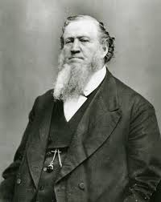
SOURCE OF KNOWLEDGE
“Every discovery in science and art that is really true and useful to mankind has been given by direct revelation from God, though but few acknowledge it.
It has been given with a view to prepare the way for the ultimate triumph of truth, and the redemption of the earth from the power of sin and Satan. We should take advantage of all these great discoveries, the accumulated wisdom of ages, and give to our children the benefit of every branch of useful knowledge, to prepare them to step forward and efficiently do their part in the great work”

Slide 4
BALANCED TRUST
I bear witness that parents who:
Consistently talk about the Book of Mormon with their children,
Share testimony spontaneously with their children, and
Invite children as gospel learners to act and not merely be acted upon,
will be blessed with eyes that can see afar off and with ears that can hear the sound of the trumpet.
The spiritual discernment and inspiration you will receive from the combination of these three holy habits will enable you to stand as watchmen on the tower for your families…

Slide 5
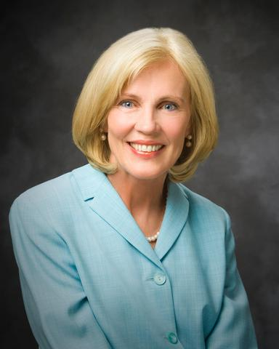
CHASTITY CHATS
Satan has increased the intensity of his attacks on your identity and virtue. If you can be dismayed, discouraged, distracted, delayed, or disqualified from being worthy to receive the guidance of the Holy Ghost or to enter the Lord’s holy temple, he wins.
The world calls to you with unrelenting, noisy voices to “live it up,” “try everything,” “experiment and be happy.” Conversely, the Holy Ghost whispers and the Lord invites you to “walk in the paths of virtue,” “lay aside the things of this world,” “and cleave unto [your] covenants.”

Slide 6
GUIDING OUR YOUTH: SOME TIPS
SOURCES OF KNOWLEDGE
Encourage youth to “Follow” members of the Twelve & other church leaders on Instagram.
You and your kids should add the Gospel Living App to your Smart Phone.
As a family, learn about “Doctrinal Mastery” and study it at home together.
BALANCED TRUST
Our children are our spiritual peers. Learn from them as much as they learn from us.
Agency is the Lord’s way. Teach and give them space to make decisions, while vigilantly looking for spiritual warning signs.
Be prayerful and work with your children as you set rules and expectations. Let them be apart of the process.
CHASTITY CHATS
Create a strong family culture of communication on chastity. The more often you talk about it, the less awkward it becomes.
Should start with and focus on WHY the Law of Chastity is important.
Understand that mistakes are made – invite youth to come to parents and Bishop if needed.

Slide 7
“[Lehi] did exhort [his children] with all the feeling of a tender parent, that they would hearken to his words . . . .”
- 1 Nephi 8:37
“Sometimes as parents we feel we have failed when our children make mistakes or stray. Parents are never failures when they do their best to love, teach, pray, and care for their children. Their faith, prayers, and efforts will be consecrated to the good of their children.
- Elder Robert D. Hales

