Slide 1
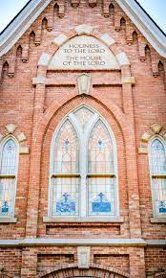
Preparing for and Improving our Temple Worship

Slide 2
“We need the temple more than anything else.” -Joseph Smith Journal, March 4, 1844, as in Teachings of Presidents of the Church: Joseph Smith [manual], p. 416

Slide 3
“Everything in the temple points us to our Savior, Jesus Christ”
-Elder David A. Bednar, April 2019 General Conference

Slide 4
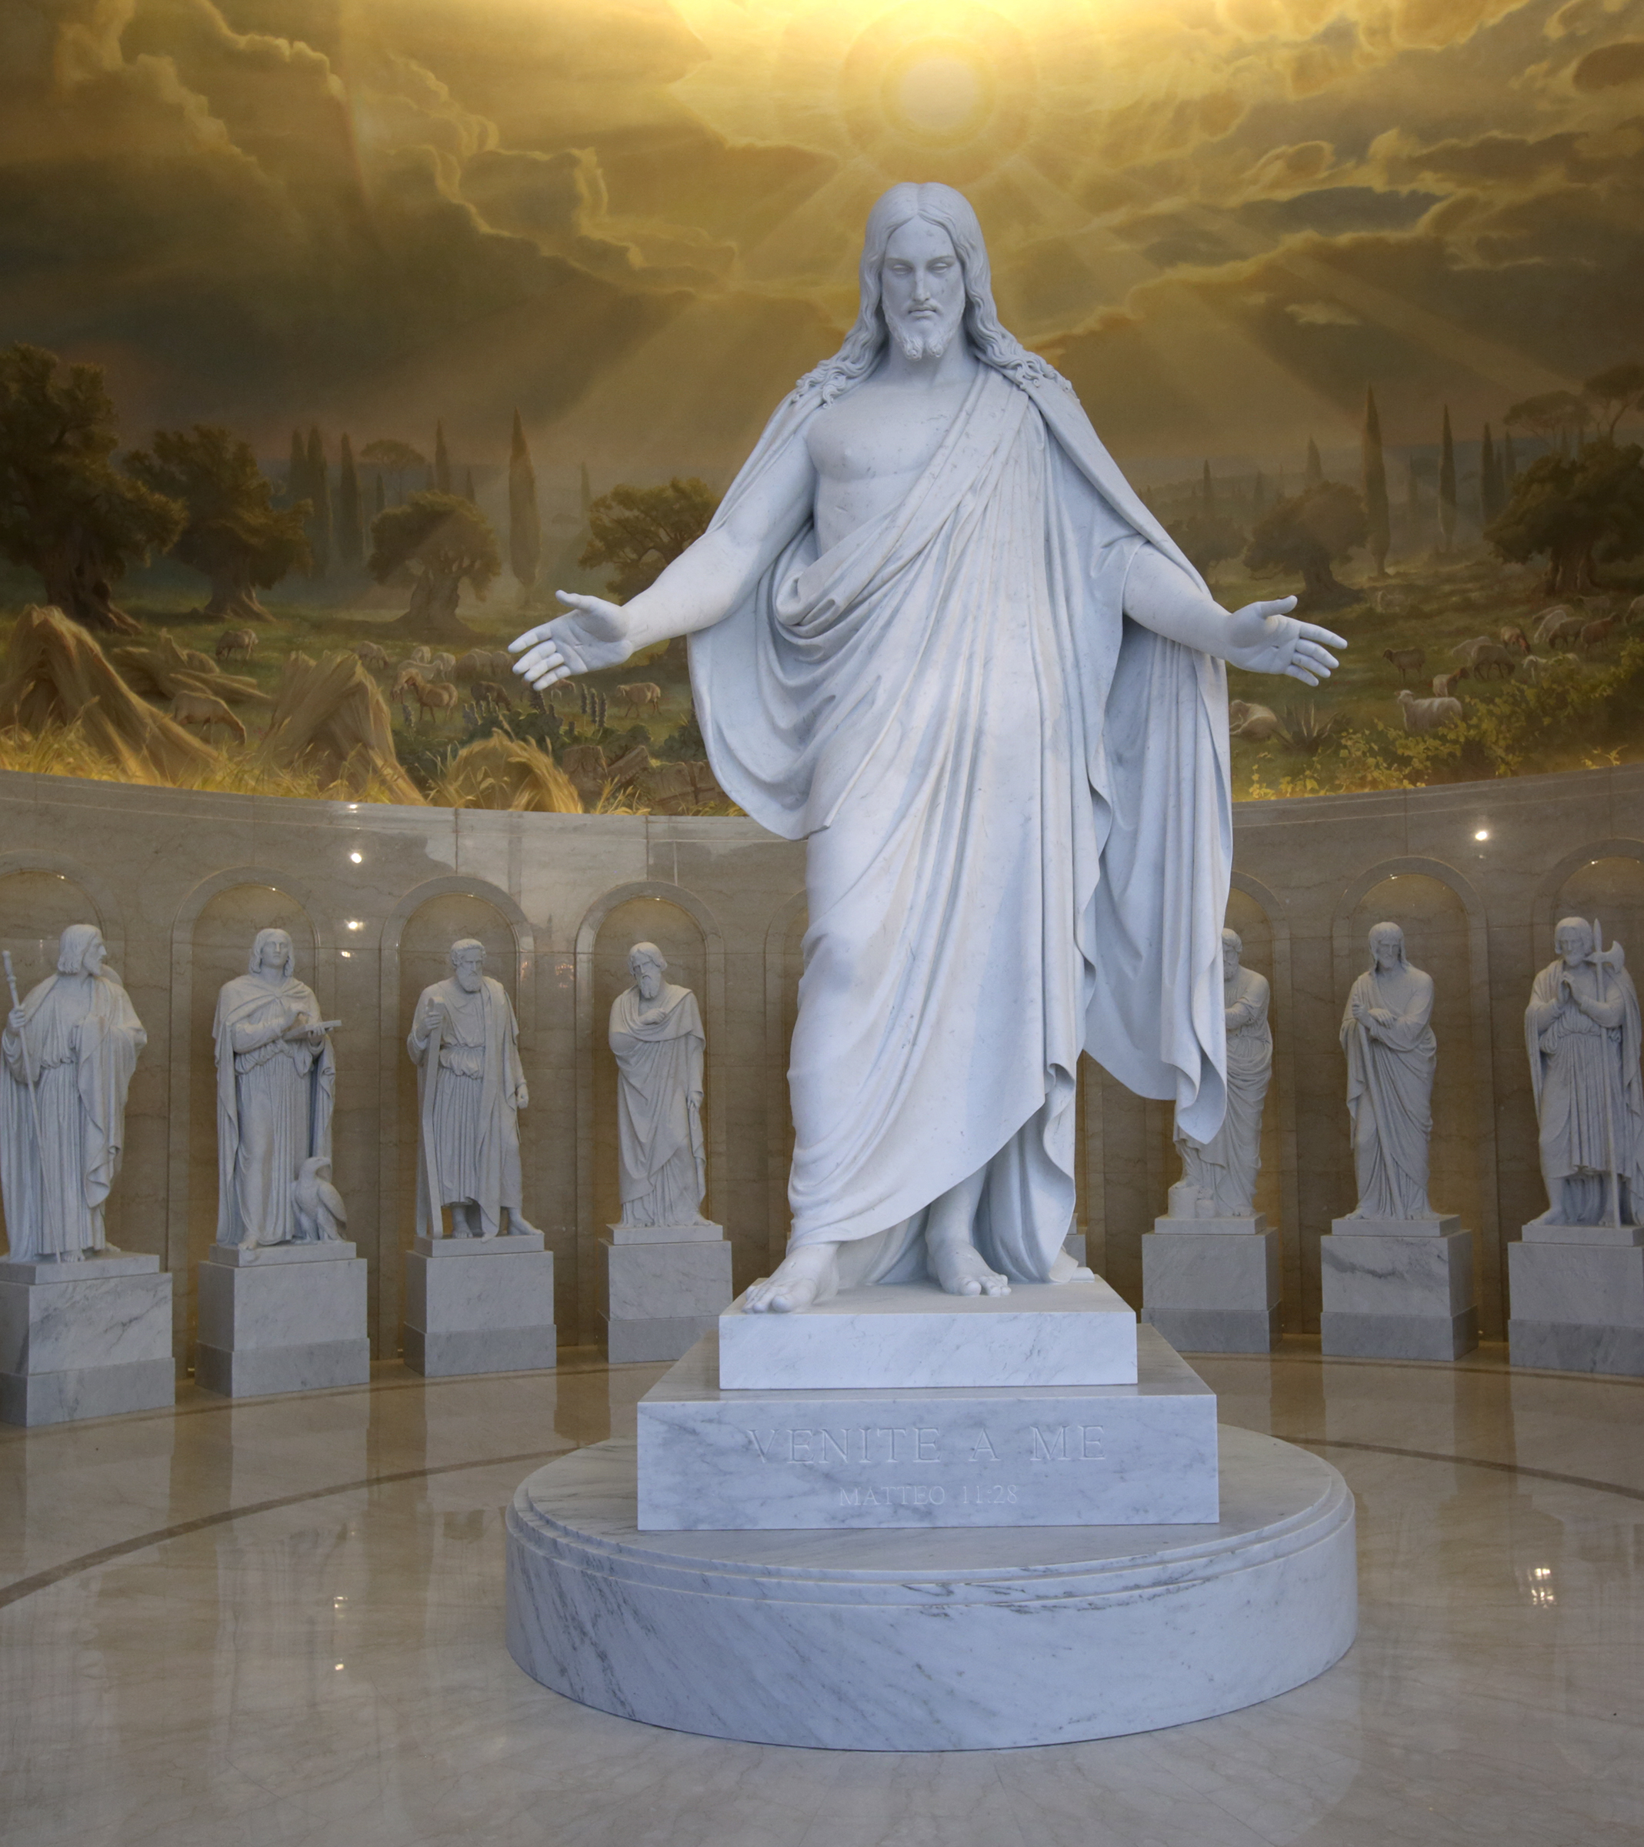
“The temple teaches of Christ.”
“The temple lies at the center of strengthening our faith and spiritual fortitude because the Savior and His doctrine are the very heart of the temple. Everything taught in the temple, through instruction and through the Spirit, increases our understanding of Jesus Christ. His essential ordinances bind us to Him through sacred priesthood covenants. Then, as we keep our covenants, He endows us with His healing, strengthening power. And oh, how we will need His power in the days ahead.”
- President Russell M. Nelson

Slide 5
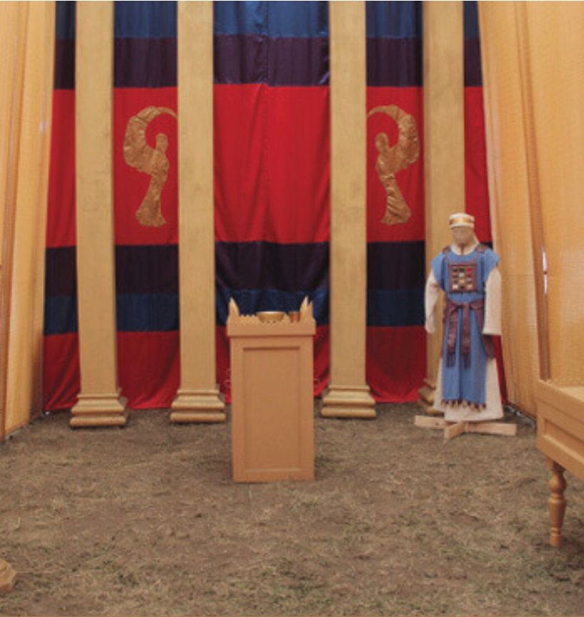
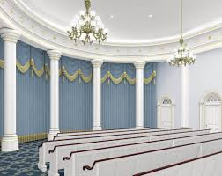
Veil of the Temple – Symbolism of Jesus
“[T]he veil signifies the flesh of Jesus Christ. The Apostle Paul wrote, “Having therefore, brethren, boldness to enter into the holiest [referring to the Holy of Holies] by the blood of Jesus [a reference to the atonement], by a new and living way, which he hath consecrated for us, through the veil, that is to say, his flesh” (Heb. 10:19-20). This image is extremely powerful! Inasmuch as the Holy of Holies represents the celestial kingdom, entering through the veil shows that the crucified Lord (the veil) stands between individuals and the presence of God (the celestial kingdom). Or, in other words, it is only through Christ and His atoning blood that one can enter into heaven.”
-175 Temple Symbols and Their Meanings by Donald W. Parry

Slide 6
Principles for Speaking of Sacred Temple Matters – “Spoken with care”
“Guideline #1. Because we love the Lord, we always should speak about His holy house with reverence. We should not disclose or describe the special symbols associated with the covenants we receive in sacred temple ceremonies. Neither should we discuss the holy information that we specifically promise in the temple not to reveal.”
“Guideline #2. The temple is the house of the Lord. Everything in the temple points us to our Savior, Jesus Christ. We may discuss the basic purposes of and the doctrine and principles associated with temple ordinances and covenants.”
–Elder David A. Bednar, “Prepared to Obtain Every Needful Thing,” April 2019 General Conference

Slide 7
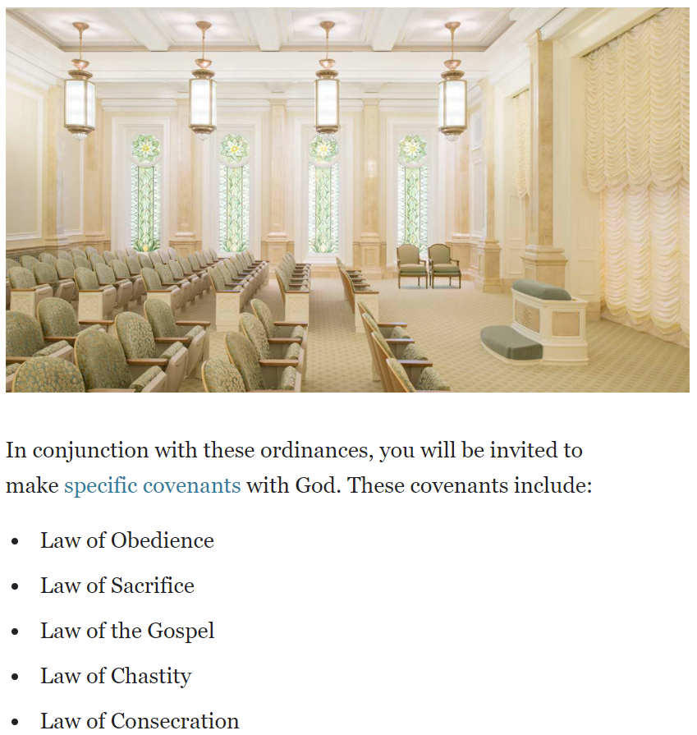
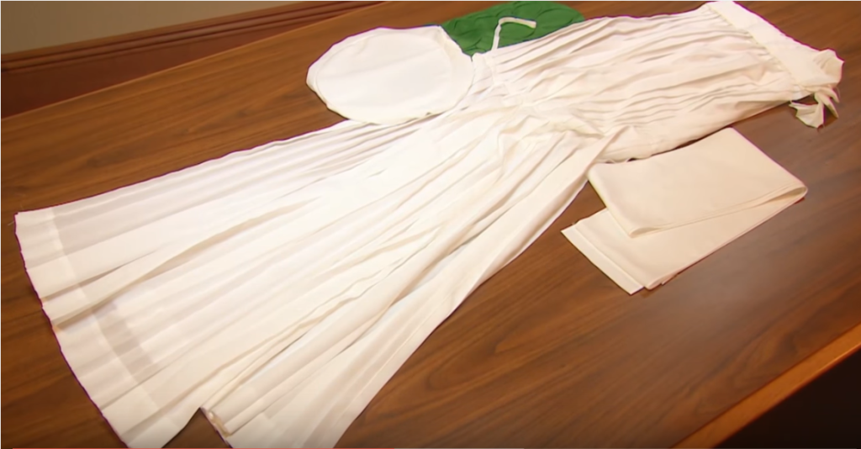
There are many aspects, including temple covenants, that we can and should talk about before we go to the temple for the first time.

Slide 8
Share our Spiritual Feelings from the Temple
“Let us share with our children the spiritual feelings we have in the temple. And let us teach them more earnestly and more comfortably the things we can appropriately say about the purposes of the house of the Lord.”
-President Howard W. Hunter, Teachings of Presidents of the Church [manual], 184.

Slide 9
Endowment Defined – Brigham Young
“Let me give you a definition in brief. Your endowment is, to receive all those ordinances in the house of the Lord, which are necessary for you, after you have departed this life, to enable you to walk back to the presence of the Father, passing the angels who stand as sentinels, being enabled to give them the key words, signs and tokens, pertaining to the Holy Priesthood, and gain your eternal exaltation.”

Slide 10
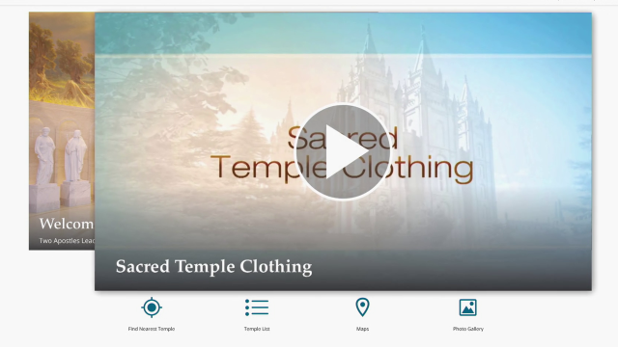
Cermonial Temple Clothing

Slide 11
The Temple Garment
“Members who receive the endowment make a covenant to wear the temple garment throughout their lives.
“It is a sacred privilege to wear the temple garment. Doing so is an outward expression of an inner commitment to follow the Savior Jesus Christ.
“The garment is a reminder of covenants made in the temple. When worn properly throughout life, it will serve as a protection.
“The garment should be worn beneath the outer clothing. It is a matter of personal preference whether other undergarments are worn over or under the temple garment.
“The garment should not be removed for activities that can reasonably be done while wearing the garment. It should not be modified to accommodate different styles of clothing.
“The garment is sacred and should be treated with respect. Endowed members should seek the guidance of the Holy Spirit to answer personal questions about wearing the garment.”
-General Handbook, 38.5.5

Slide 12
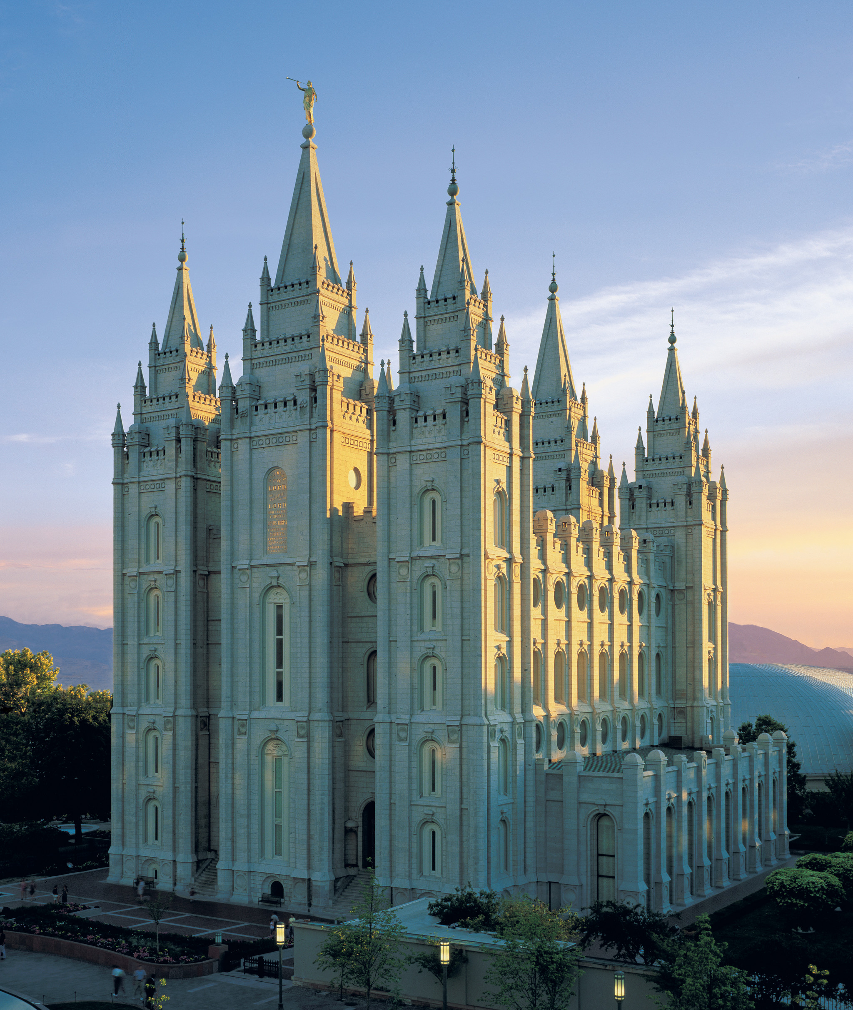
-Standard Works -Home Discussions -Gospel Library/Church Website -Stake Mission & Temple Prep -Bishop Interview -Stake President Interview
RICH RESERVOIR OF RESOURCES

Slide 13
Scriptures as Temple Preparation Resource
“I recommend that members … read entries in the Bible Dictionary that are related to the temple, such as ‘Anoint,’ ‘Covenant,’ ‘Sacrifices,’ and ‘Temple.’ One may also wish to read Exodus, chapters 26–29, and Leviticus, chapter 8. The Old Testament, as well as the books of Moses and Abraham in the Pearl of Great Price, underscores the antiquity of temple work and the enduring nature of its ordinances.”
-President Russell M. Nelson, “Prepare for the Blessings of the Temple,” Ensign, October 2010

Slide 14
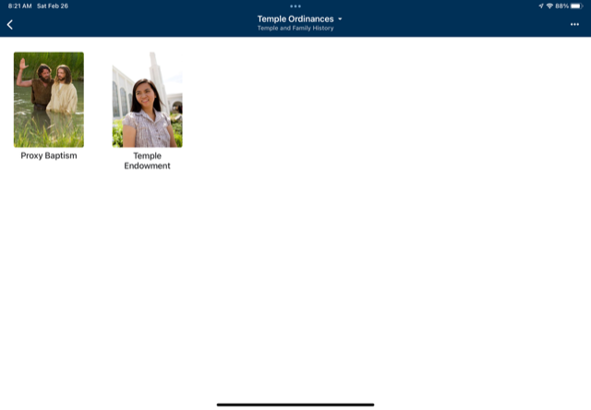
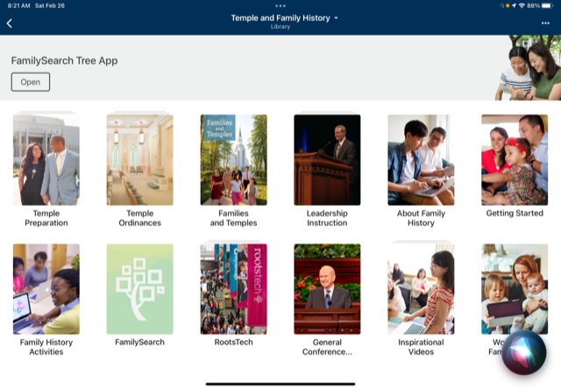
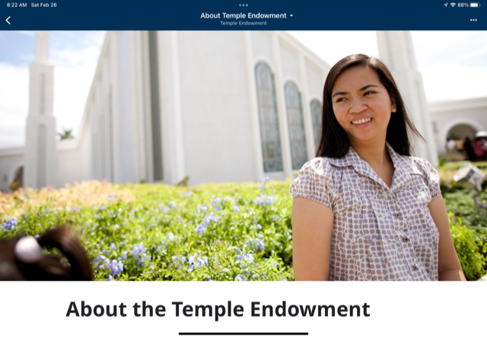
Gospel Library Resources
#1 Library Home Page
#3 Temple Ordinances
#4 About the Temple Endowment
#2 Temple and Family History

Slide 15
https://www.churchofjesuschrist/temples/prophetic-teachings-on-temples?lang=eng

Slide 17
President Boyd K. Packer: The Holy Temple
BOOKS
Anthony Sweat: The Holy Invitation
The Holy Covenants

Slide 18
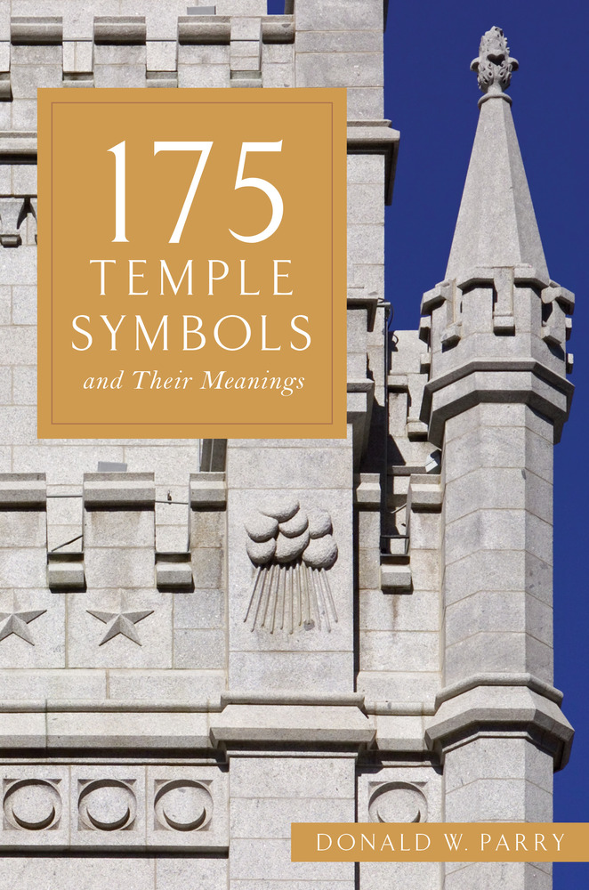
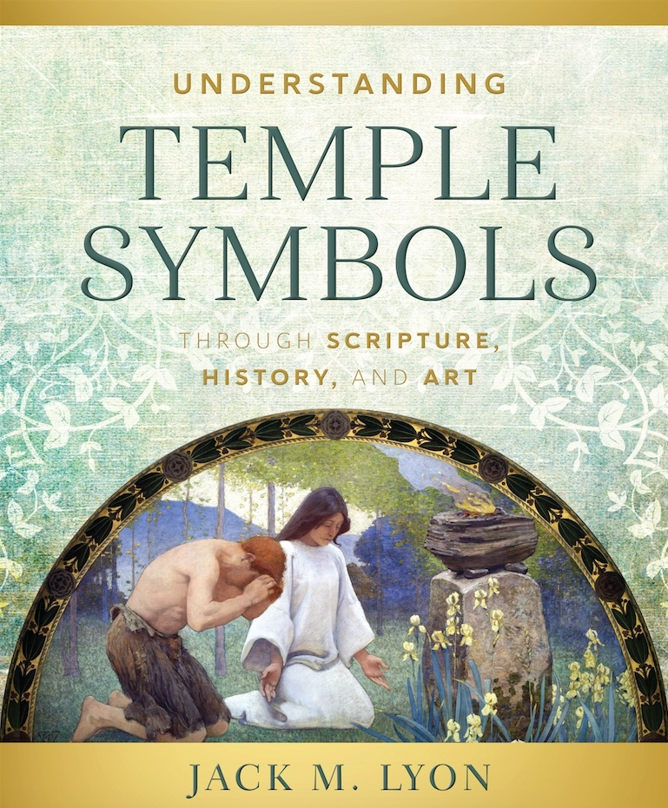
Donald W. Parry: The Holy Temple
BOOKS – TEMPLE SYMBOLISM
Jack M. Lyon: Understanding Temple Symbols Through Scripture, History and Art

Slide 19
TALKS/ARTICLES
Ezra Taft Benson, “What I Hope You Will Teach Your Children About the Temple,” Ensign, August 1985, 8.
Russell M. Nelson, “Prepare for the Blessings of the Temple,” Ensign, October 2010, 47.
David A. Bedar, “Prepared to Obtain Every Needful Thing,” April 2019 General Conference
Carlos E. Asay, “The Temple Garment: An Outward Expression of an Inward Commitment,” Ensign, August 1997

Slide 20
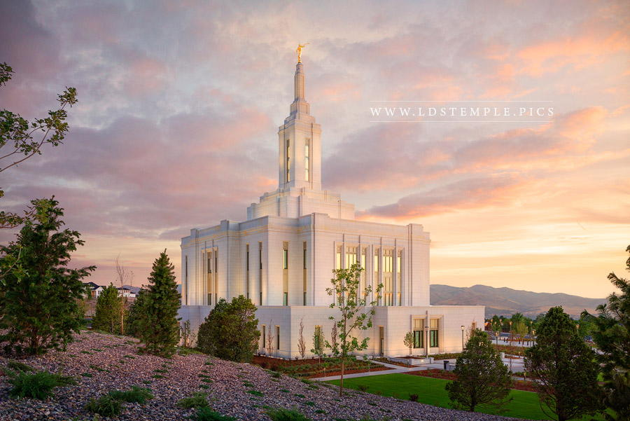
8 Verily I say unto you, all among them who know their hearts are honest, and are broken, and their spirits contrite, and are willing to observe their covenants by sacrifice—yea, every sacrifice which I, the Lord, shall command—they are accepted of me. (D&C 97:8)
Observe Covenants by Sacrifice

Slide 21
“Live the law of obedience and strive to keep Heavenly Father’s commandments.” General Handbook, 27.2
Law of Obedience

Slide 22
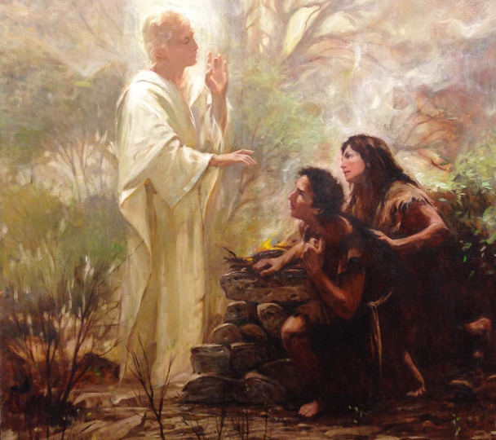
“Obey the law of sacrifice, which means sacrificing to support the Lord’s work and repenting with a broken heart and contrite spirit.” General Handbook, 27.2
Law of Sacrifice

Slide 23
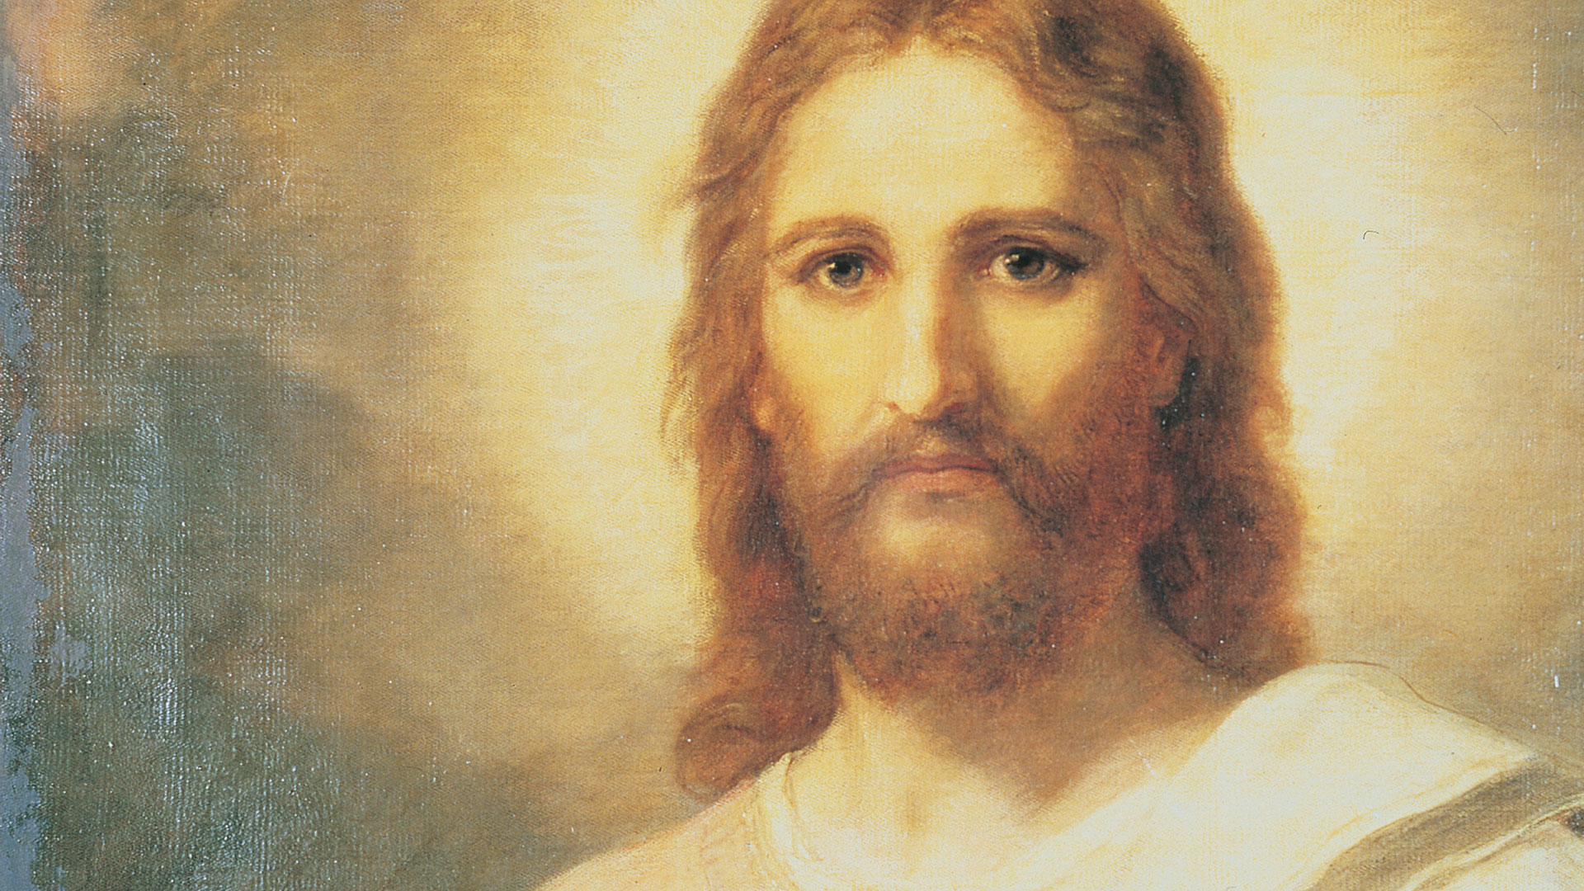
“Obey the law of the gospel of Jesus Christ, which is the higher law that He taught while He was on the earth.” General Handbook, 27.2
Law of the Gospel

Slide 24
“Keep the law of chastity, which means that a member has sexual relations only with the person to whom he or she is legally and lawfully wedded according to God’s law.” General Handbook, 27.2
Law of Chastity

Slide 25
“Keep the law of consecration, which means dedicating their time, talents, and everything with which the Lord has blessed them to building up Jesus Christ’s Church on the earth.” General Handbook, 27.2
Law of Consecration

Slide 26
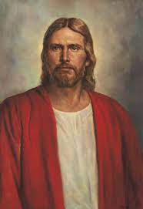
“The temple is the house of the Lord. The basis for every temple ordinance and covenant—the heart of the plan of salvation—is the Atonement of Jesus Christ. Every activity, every lesson, all we do in the Church, point to the Lord and His holy house.” -President Russell M. Nelson
Jesus Christ and His Temples

