Slide 1
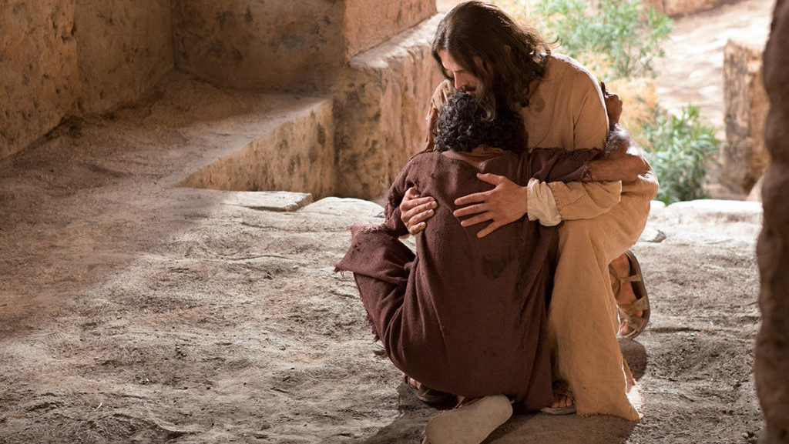
DEEPENING CONVERSION:
REPENTENCE

Slide 2
Notes:
We want to bring two particular resources to your attention. We’re studying this as a Stake Council. It’s been converted into an institute class and curriculum.

Slide 3
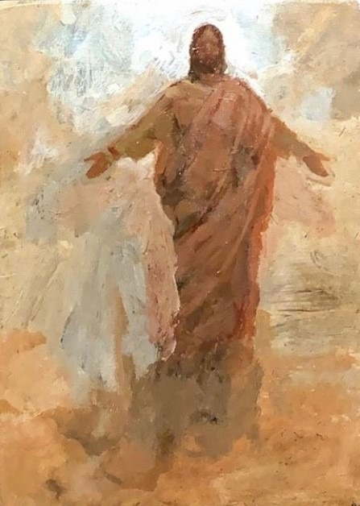
Behold, he sendeth an invitation unto all men, for the arms of mercy are extended towards them, and he saith: Repent, and I will receive you.”
- Alma 5:33
Notes:
Seminary asked, what’s a go to scripture when you feel sad. I have two, and this is one of them. Alma 5 gives such a great perspective on life --- we’re doing fine in some things, but fall short in others. But, we can’t be down about that because the gospel of Jesus Christ gives us hope. Christ is the deliverer of that hope. Let’s read this scripture together. What are your perspectives on this scripture --- what speaks to you?

Slide 4
What is Repentance? Has Your View Changed Over Time?
What would a primary child say?
What would a teenager say?
What would a missionary say?
What would a young adult say?
What would a parent say?
What would a bishop say?
What would a grandparent say?
Notes:
President Ballard’s talk in October 2019 really struck me as I listened to him talk about daily repentance and what a joy that is for him in his life. I’ve also realized that my view on repentance has changed over time and changes depending on phases of life. [DISCUSSION]. Clearly, repentance means different things to different people. It’s an intimate act between them and their Heavenly Father that has Jesus in the middle.

Slide 5
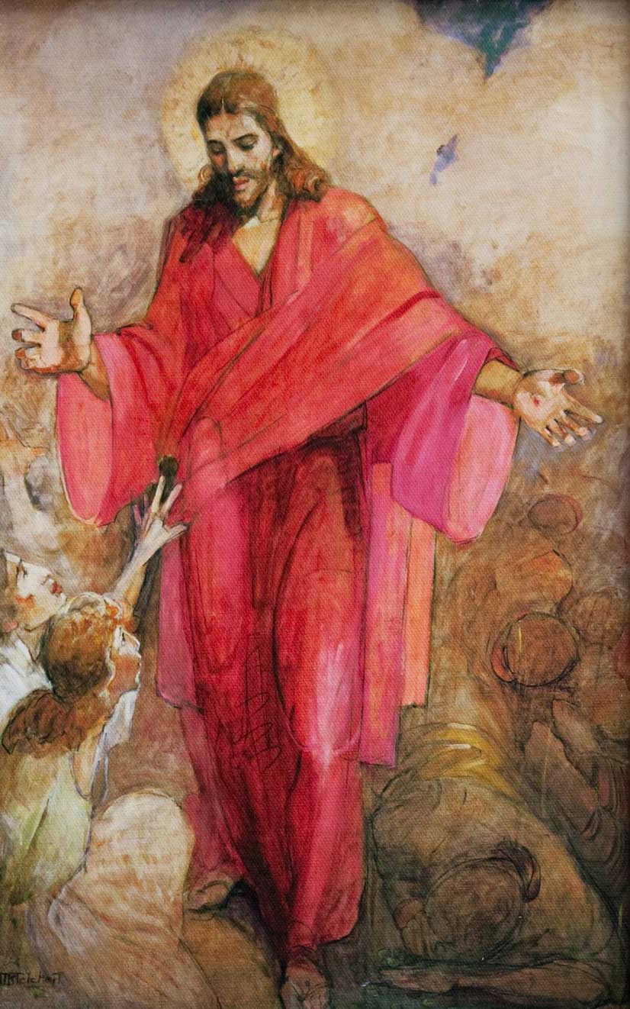
When Christ invites us to repent, what is he inviting us to do?
Gospel Topics Definition:
“It is a change of mind and heart that gives us a fresh view about God, about ourselves, and about the world.”
Notes:
Here’s a definition that I think is really helpful --- from the Gospel Topics section of the scriptures. But, how does this happen? Let’s talk about this part about a fresh view about God. What does that mean? What about ourselves? What about the world? Let’s read Alma 5:7. What does a change of heart look like? [WHITEBOARD ANSWERS]

Slide 6
When Christ invites us to repent, what is he inviting us to do?
President Nelson’s Answer:
When Jesus asks you and me to ‘repent,’ He is inviting us to change our mind, our knowledge, our spirit — even the way we breathe. He is asking us to change the way we love, think, serve, spend our time, treat our [spouse], teach our children and even care for our bodies.”
Notes:
President Nelson applies this definition and its scriptural foundation to issues of our day.

Slide 7
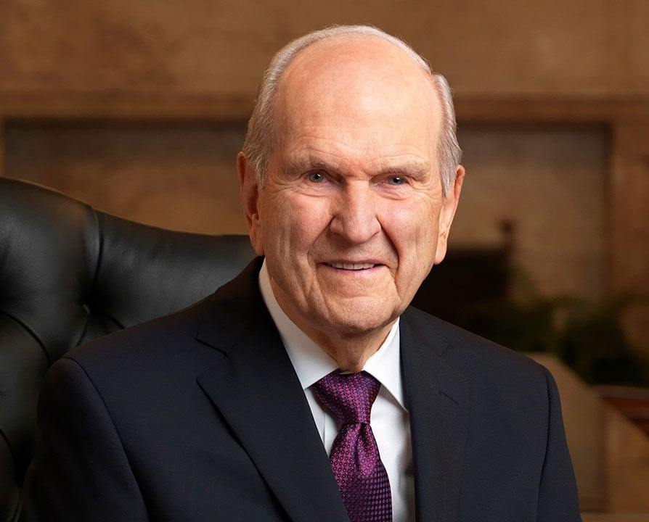
A Prophet’s Counsel
“Whether you are diligently moving along the covenant path, have slipped or stepped from the covenant path or can’t even see the path from where you are now, I plead with you to repent. Experience the strengthening power of daily repentance — of doing and being a little better each day.”
Notes:
We have slips, we even step. We tumble. But, the path is always there. And Christ is there to pull you back onto it. All we need to do is repent daily. Said another way, we just need to change daily. Turn our hearts to Him just a little more each day by how we act, treat others, serve. Highland Seminary: How to stay Christ-centered in a busy life? THIS IS THE ANSWER --- make a daily effort to change our hearts bit by bit.

Slide 8
Three Invitations to Improve Daily Repentance:
What will I do so that the Lord will reveal to me where my repentance should be focused?
What will I do if the Lord prompts me to make changes that I don’t want to make?
How will I go forward “inch by inch” as I strive to repent daily?
Notes:
A little homework; a takeaway. Comments about each of these re how they will help us with this change of heart and mind?

Slide 9
“The invitation to repent is rarely a voice of chastisement but rather a loving appeal to turn around and to “re-turn” toward God. It is the beckoning of a loving Father and His Only Begotten Son to be more than we are, to reach up to a higher way of life, to change, and to feel the happiness of keeping the commandments. Being disciples of Christ, we rejoice in the blessing of repenting and the joy of being forgiven. They become part of us, shaping the way we think and feel.”
- Neil L. Andersen
Notes:
God wants us to be happy. Shame and inadequacy are not feelings from him. Adam and Eve – Satan said to run and hide. Not God. God said, come out, into the light---I have great news. Your stumbles, your falls, that is part of my plan. And here is my Son, who has made it possible for you to stay in the light, to get back on track, and to return to live happily with me. Rejoice in that---that you can start anew and have the strength to improve each day.

