Slide 1
The Godhead Deepening Conversion Through Gospel Study

Slide 2
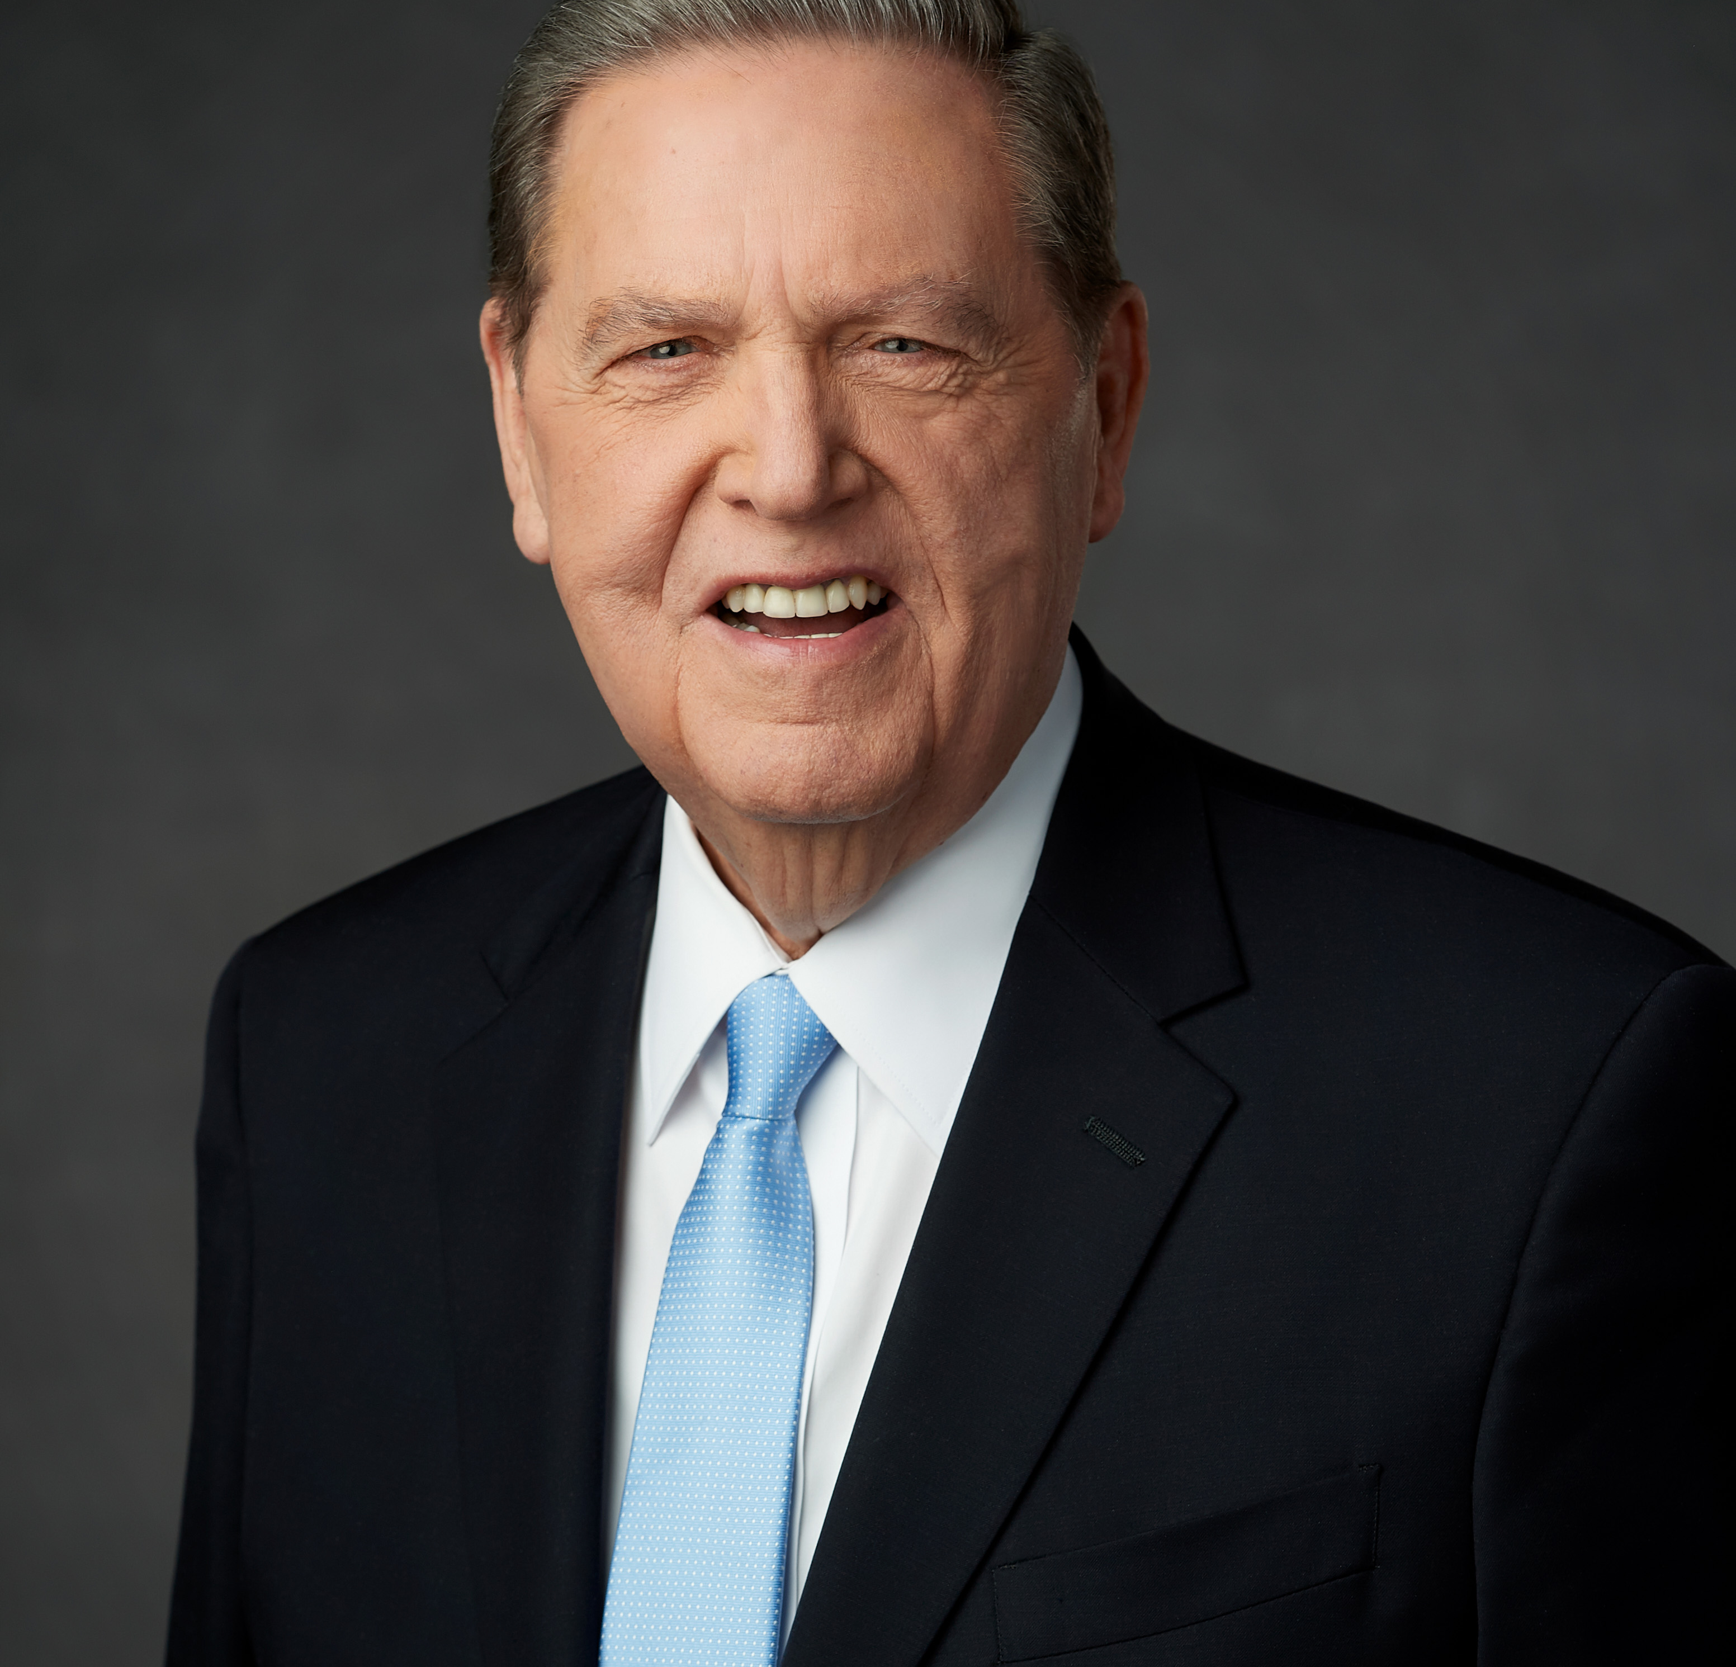
There is no point in going on to the other truths we believe if we haven’t fixed in our minds and in the minds of those we teach the preeminent role of the Godhead in our doctrine and in our eternal destiny. We are to know these Divine Beings in every way we can. We are to love Them, draw near to Them, obey Them, and try to be like Them.

Slide 3
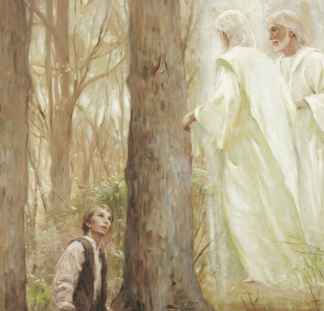
The Prophet Joseph Smith said, “It is the first principle of the gospel to know for a certainty the character of God.”
“I want you all to know Him, and to be familiar with Him.” We must have “a correct idea of his perfections, and attributes” and an admiration for “the excellency of [His] character.”

Slide 4
God the Father
“God is our Heavenly Father. We are His children. He has a body of flesh and bone that is glorified and perfected. He loves us. He understands and feels our sorrows and rejoices in our progress. He wants to communicate with us, and we can communicate with Him through sincere prayer.” Preach My Gospel, Lesson 1.
“After this manner therefore pray ye: Our Father which art in heaven, Hallowed be thy name.” Matthew 6:9
“I am the Beginning and the End, the Almighty God; by mine Only Begotten I created these things; yea, in the beginning I created the heaven, and the earth upon which thou standest.” Moses 2:1
“And lo a voice from heaven, saying, This is my beloved Son, in whom I am well pleased.” Matthew 3:17
“When the light rested upon me I saw two Personages, whose brightness and glory defy all description, standing above me in the air. One of them spake unto me, calling me by name and said, pointing to the other—This is My Beloved Son. Hear Him!” JSH 1:17

Slide 5
Jesus Christ

Slide 6
Jesus Christ

Slide 7
Jesus Christ
He was the Great Jehovah of the Old Testament, the Messiah of the New.
Under the direction of His Father, He was the creator of the earth. “All things were made by him; and without him was not any thing made that was made” (John 1:3).
Though sinless, He was baptized to fulfill all righteousness.
He walked the roads of Palestine, healing the sick, causing the blind to see, and raising the dead.
He gave His life to atone for the sins of all mankind. His was a great vicarious gift in behalf of all who would ever live upon the earth.
He rose from the grave to “become the firstfruits of them that slept.”
He will someday return to earth. “And the glory of the Lord shall be revealed, and all flesh shall see it together” (Isaiah 40:5).
He is the light, the life, and the hope of the world. His way is the path that leads to happiness in this life and eternal life in the world to come.
The Living Christ

Slide 8
The Holy Ghost
The Holy Ghost is the third member of the Godhead. He is a personage of spirit, without a body of flesh and bones. He is often referred to as the Spirit, the Holy Spirit, the Spirit of God, the Spirit of the Lord, or the Comforter.
“Ye have received the Holy Ghost, which witnesses of the Father and the Son, unto the fulfilling of the promise which he hath made, that if ye entered in by the way ye should receive.” 2 Nephi 31:18
“These things have I spoken unto you, being yet present with you. But the Comforter, which is the Holy Ghost, whom the Father will send in my name, he shall teach you all things, and bring all things to your remembrance, whatsoever I have said unto you. Peace I leave with you, my peace I give unto you: not as the world giveth, give I unto you. Let not your heart be troubled, neither let it be afraid.” John 14:25-27.
“And by the power of the Holy Ghost ye may know the truth of all things.” Moroni 10:5

